Slide 1
Misuse and Abuse Cases:
Getting Past the Positive

Slide 2
Background
Software development is all about making software do something:
when software vendors sell their products, they talk about what the products do to make customers’ lives easier, such as encapsulating business processes or something similarly positive

Slide 3
Experienced customers are beginning to demand secure and reliable software.
To create secure and reliable software, we first must anticipate abnormal behavior.
We don’t normally describe non-normative behavior in use cases, nor do we describe it with UML, but we must have some way to talk about and prepare for it.
“Misuse” (or “abuse”) cases can help organizations begin to see their software in the same light that attackers do.

Slide 4
Security is not a set of features
Cryptography of one kind or another is usually necessary to create a secure system, but security features alone are not sufficient for building secure software.
It cannot be patched in after attacks have occurred in the field.
It must be built as a critical part of the design from the very beginning (requirements specification) and included in every subsequent development phase all the way through fielding a complete system.

Slide 5
For example, ease of use might be paramount in a medical system designed for secretaries in doctors’ offices, but complex authentication procedures, such as obtaining and using a cryptographic identity, can be hard to use.
Technical approaches must go far beyond the obvious features, deep into the many-tiered heart of a software system to provide enough security: authentication and authorization can’t stop at a program’s front door.

Slide 6
The best, most cost-effective approach to software security incorporates thinking beyond normative features and incorporates that thinking throughout the development process.
Every time a new requirement, feature, or use case is created, someone should spend some time thinking about how that feature might be unintentionally misused or intentionally abused.
Professionals who know how features are attacked and how to protect software should play an active role in this kind of analysis.

Slide 7
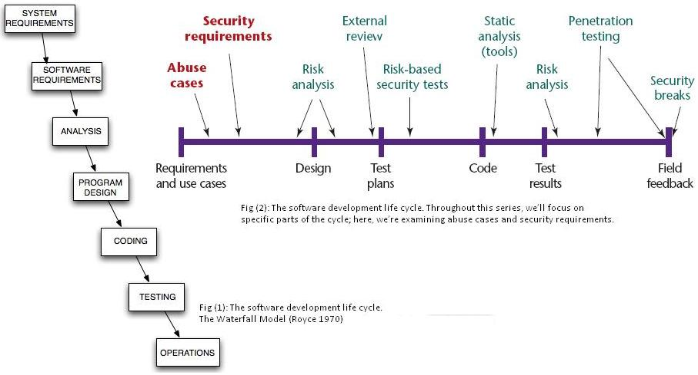
Comparison of Original and proposed software development life cycle

Slide 8
Thinking about what you can’t do
Attackers always probe well-known locations—boundary conditions, edges, intersystem communication, and system assumptions—in the course of their attacks.
Clever attackers will try to undermine the assumptions on which a system was built.
If the software design assumes that the client never modifies its Web browser cookies before they are sent back to the requesting server, attackers will intentionally cause problems by modifying the cookies
Building Secure Software teaches us that we have to be on guard with all of our assumptions.

Slide 9
A system’s creators are not the best security analysts of that system
Knowledge to the benefit of security and reliability, can be gained by asking and answering the following critical questions:
    What assumptions are implicit in our system?
    What kinds of things make our assumptions false?
    What kinds of attack patterns will an attacker bring to bear?
Subject matter experts (SMEs) and security analysts can ferret out base assumptions in a system under analysis and think through the ways an attacker will approach the software.

Slide 10
Creating useful misuse cases
One of the goals of misuse cases is to decide and document a priori how software should react to illegitimate use.
The simplest, practical method for creating misuse cases is usually with the process of brainstorming.
A more practical approach is team security and reliability experts with SMEs. This approach relies heavily on expertise and covers a lot of ground quickly.

Slide 11
To guide brainstorming, software security experts ask many questions of a system’s designers to help identify the places where the system is likely to have weaknesses.
Such brainstorming involves a careful look at all user interfaces and considers events that developers assume a person can’t or won’t do.
Attackers, unfortunately, can make these cant's and won’ts happen.

Slide 12
An abuse case example
Cigital recently reviewed a client-server application and found a classic software security problem.
The architecture had been set up so that the server relied on the client-side application, which manipulated a financially sensitive database, to manage all data-access permissions & no permissions were enforced on the server itself.
The client also enforced which messages were sent to the server, the server assumed that any messages coming from the client had passed the client software’s access control system and were, therefore, legitimate.

Slide 13
By intercepting network traffic, corrupting values in the client software’s cache, or building a hostile client, malicious users could inject data into the database that they were not even supposed to read and write.
Determining the cant's and won’ts in such a case is difficult for those who think only about positive features.
Attack patterns can provide some guidance while we are creating misuse and abuse cases.

Slide 14
Attack patterns
Attack patterns are extremely useful in generating valid abuse and misuse cases. Few of the attackers pattern are shown here:
  Make the client invisible
  Target programs that write to privileged OS resources
  Attack user-supplied configuration files that run commands
  to elevate privilege
  Leverage configuration file search paths
  Manipulate terminal devices
  Perform simple script injection
  Pass local file names to functions that expect a URL
  Inject functions into content-based file systems
  Use alternative IP addresses and encodings
  Force a buffer overflow in an API call

Slide 15
Thank You
Sridhar Rayappagari
Vinod Kothapalli
Ashwin Karmilla
Pradeep Vasamsetti

